Slide 1
Ethical Hacking and Penetration Testing
Ethical Hacking Overview
Last modified 8-21-14

Slide 2
Introduction to Ethical Hacking
Ethical hackers
Employed by companies to perform penetration tests
Penetration test
Legal attempt to break into a company’s network to find its weakest link
Tester only reports findings, does not solve problems
Security test
More than an attempt to break in; also includes analyzing company’s security policy and procedures
Tester offers solutions to secure or protect the network

Slide 3
The Role of Security and Penetration Testers
Experienced penetration testers write programs or scripts using these languages
Practical Extraction and Report Language (Perl), C, C++, Python, JavaScript, Visual Basic, SQL, and many others

Slide 4
It Takes Time to Become a Hacker
This module alone won’t make you a hacker, or an expert
It usually takes years of study and experience to earn respect in the hacker community
It’s a hobby, a lifestyle, and an attitude
A drive to figure out how things work

Slide 5
The Role of Security and Penetration Testers
Tiger Team
Sponsored individuals with specific expertise
Test system security
Tiger box
Collection of OSs and hacking tools
Usually on a laptop
Helps penetration testers and security testers conduct vulnerabilities assessments and attacks

Slide 6
Penetration-Testing Methodologies
White box model
Tester is told everything about the network topology and technology
Network diagram
Tester is authorized to interview IT personnel and company employees
Makes tester’s job a little easier

Slide 7
Penetration-Testing Methodologies
Black box model
Company staff does not know about the test
Tester is not given details about the network
Burden is on the tester to find these details
Tests if security personnel are able to detect an attack

Slide 8
Penetration-Testing Methodologies
Gray box model
Hybrid of the white and black box models
Company gives tester partial information

Slide 9
Penetration-Testing goals
Determine feasibility of a particular set of attack methods
Identify high-risk vulnerabilities from a combination of lower-risk vulnerabilities exploited in a particular sequence
Identify vulnerabilities that may be difficult or impossible to detect with automated network or application vulnerability scanning software
Assess the magnitude of potential business and operational impacts of successful attacks

Slide 10
Penetration-Testing goals cont.
Test the ability of network defenders to detect and respond to attacks
Provide evidence to support increased investments in security personnel and technology
Report to the system owner.
Penetration test reports should also assess potential impacts to the organization and suggest countermeasures to reduce risk.

Slide 11
What You Can Do Legally
Laws involving technology change as rapidly as technology itself
Find what is legal for you locally
Laws change from place to place
Be aware of what is allowed and what is not allowed

Slide 12
Laws of the Land
Tools on your computer might be illegal to possess
Know the (local) law before installing hacking tools
Written words are open to interpretation
Governments are getting more serious about punishment for cybercrimes

Slide 13
Is Port Scanning Legal?
Some countries deem it legal
Not always the case
The US Federal Government does not see it as a violation
Allows each state to address it separately
EU Policy on penetration testing will be published in 2016
Read your ISP’s “Acceptable Use Policy”
IRC “bots” may be forbidden
Program that sends automatic responses to users
Gives the appearance of a person being present

Slide 14
What You Cannot Do Legally
Accessing a computer without permission is illegal
Other illegal actions
Installing worms or viruses
Denial of Service attacks
Denying users access to network resources
Be careful your actions do not prevent Users from performing their day to day tasks

Slide 15
Get It in Writing
Using a contract is just good business
Contracts may be useful in court
Internet can also be a useful resource
Have a legal expert read over your contract before sending or signing it

Slide 16
Ethical Hacking in a Nutshell
What it takes to be a security tester
Knowledge of network and computer technology
Ability to communicate with management and IT personnel
Understanding of the laws
Ability to use necessary tools

Slide 17
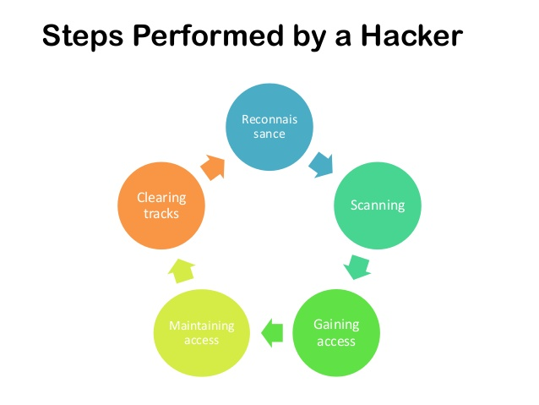
Ethical Hacking in a Nutshell

Slide 18
How to become an Ethical Hacker
You need to meet the following requirements:
Should be proficient with programming and computer networking skills
Should be familiar with vulnerability research
Should have good knowledge of hacking techniques
Should be prepared to follow a strict code of conduct

Slide 19
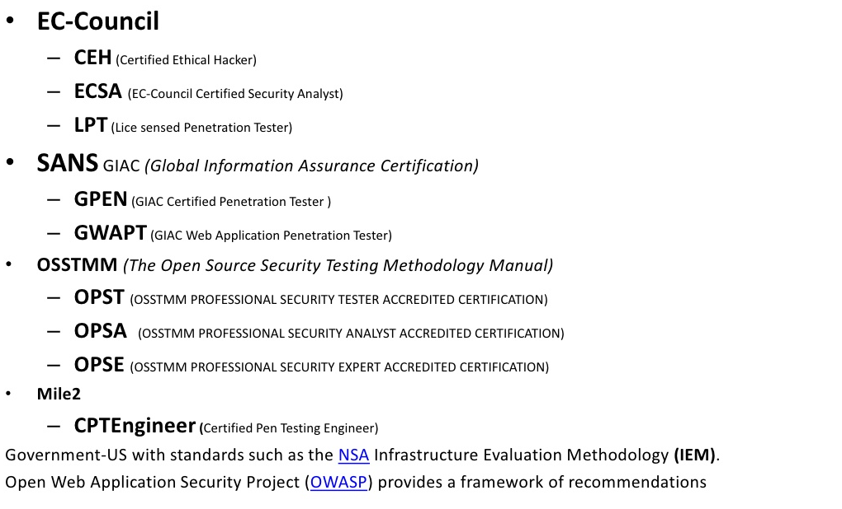
Some Global Certificates

Slide 20
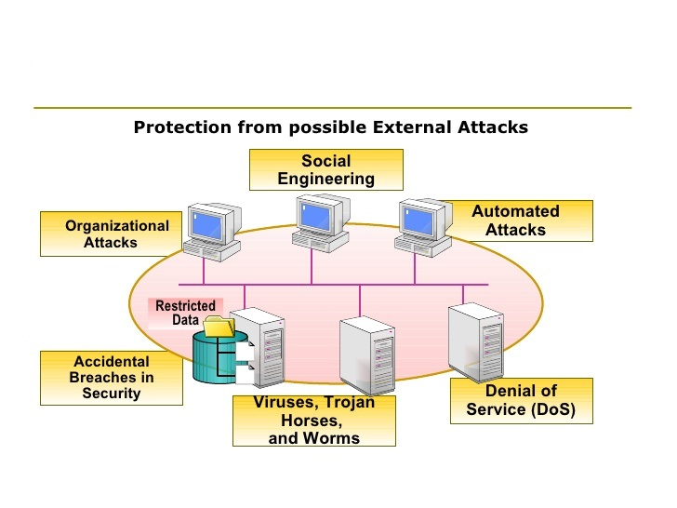
Ethical Hacking

Slide 21
Ethical Hacking & Penetration testing
Stage 1
Reconnaissance – Information gathering
Passive vs Active
Tools used
Stage 2
Scanning – Specific details about a networked system
port, network, vulnerability
Nmap, Nessus
Stage 3
Attempted Access – Penetration attempts
LAN, Internet, Intranet, Extranet
Stage 4
Ownership – change access rights to maintain full functionality
Stage 5
Hide presence- continued use of the system, change log files

Slide 22
Footprinting Tools:
Whois
Nslookup
ARIN
Neo Trace
NetBrute
Nmap
Traceroute
Website watcher
E-mail Spider

Slide 23
Penetration vs Vulnerability Test
Vulnerability testing – identify weaknesses
Pen test :
identify measures to combat
actively testing security measures
reporting recommendations

Slide 24
Penetration Testing Methodology
A penetration test involves the systematic review of all security measures in place.
A project should include all or most of the following areas:
Network Security
Wireless Security
Information Security
Communications Security
Social Engineering
Physical Security

Slide 25
Penetration Testing Security Approach
External pen test
Internal security awareness
Applications security assessment
Network Assessment
Wireless/ Remote access assessment
Communications security assessment
Staff/user Training

Slide 26
And finally,
“To catch a hacker think like a hacker”.

